Slide 1
Database Systems
AICT005-4-1-Database Systems (version1)
AICT015-4-1-Database Management
Module Introduction and Overview

Slide 2
Lecturer information
Lecturer Name: Ms. Lai Chew Ping
Email: chewping@staffemail.apu.edu.my
Office: Level 5, Computing Staff Room

Slide 3
Pre-requisites for this module
None

Slide 4
Aims of this module
This module introduces the students with fundamental knowledge of database design and management system. Students shall be able to analyze a case study and model the database using entity relationship diagram. Database normalization is introduced to control data redundancy. The module also covers practical software skills using Structured Query Language (SQL) which enables the students to implement and manipulate a database.

Slide 5
Course Learning outcomes, CLOs
At the end of this course, YOU should be able to:
State the fundamental concept of database, database management system and relational model.
Manipulate the database with ERD, Normalization and SQL.
Apply redundancy control in designing a database.
Demonstrate a database solution using an appropriate tool based on a case study.

Slide 6
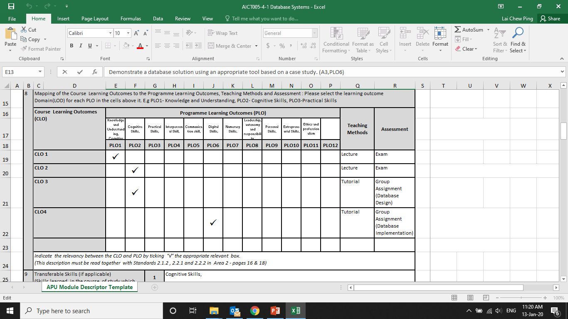
Mapping of CLOs with MOEs Domain
PLO1 – Knowledge and understanding
PLO3 – Cognitive Skills
PLO6 – Digital Skills

Slide 7
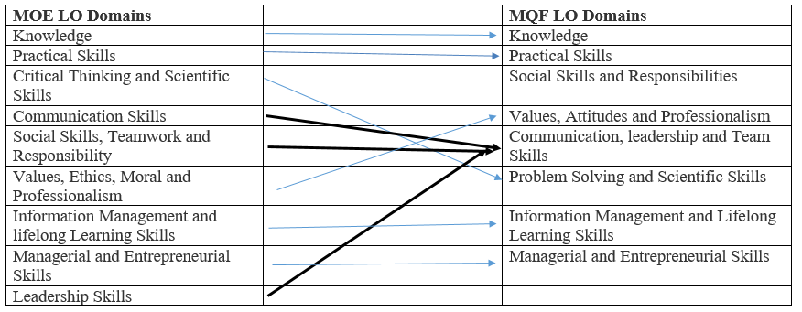
MQF and MOE Domains

Slide 8
Teaching Strategies
Lecture
Tutorial (Lab)
Case Study (Individual and Group)

Slide 9
Assessment Methods
Final Exam (50%) : CLO1 & CLO2
Group Assignment (50%): CLO3, CLO4
3 to 4 students on a group
Online submission
Part 1: Database Design (due on week 8)
Part 2: Database Implementation (due on week 13)

Slide 10
Student Learning Time (SLT)
Course Credit Value: 4
Total Learning Hours:
Lecture: 28 hours per semester
Tutorial / Lab : 28 hours per semester
Independent Learning Time: 88 hours

Slide 11
Methods of Delivery
Hence,
We are now moving from the traditional topic based teaching to outcome-based education

Slide 12
Outcomes Based Education (OBE)
OBE is education based on producing particular educational outcomes that:
Focus on what students can actually do after they are taught
Expect all learners / students to successfully achieve particular (sometimes minimum) level of knowledge and abilities.

Slide 13
So…What is OBE?
It’s
NOT
What we want to teach,
It’s
What You should learn

Slide 14
Course Content Outline
CLO1 & CLO2 : Final Exam (50%)
Lecture
Introduction to Database
Database management system and functions
Database environment
Relational database concept
Data modeling with entity relationship diagram
Database Normalization
Structure Query Language (SQL)

Slide 15
Course Content Outline
CLO3 : Group Assignment (50%)
Tutorial / Case Study
Database design and modeling
Database redundancy control
Relational schema mapping
Database management tools and functions
Define a database using Data Definition Language (DDL) Manipulate a database using Data Manipulation Language (DML)
Analyze a case study and implement a database solution

Slide 16
What is expected of you
What is expected of you
You should abide to all the rules & regulation of APU
Proper attire
No speaking of dialects
Attendance is compulsory and valid medical certificates or letters from parents /guardians must support any absence from class.
Three lateness will be equal to one absence
Mobile phone should be turned off during lectures.

Slide 17
What support is available for you
Consultation hours / Ms.TEAMS
Resources
Reference material
Essential Reading
Coronel, C., Morris, S. (2018). Database Systems: Design, Implementation, & Management. 13th ed. Course Technology. ISBN-13: 978-1111969608
M. Kroenke, D., J. Auer, D., L. Vandenberg, S., Yoder, R.C. (2017). Database Concepts. 8th ed. Pearson. ISBN:9780134601694
Harrington, J. (2016). Relational Database Design and Implementation. 4th ed. Morgan Kaufmann. ISBN: 9780128043998
Internet resources
Software : Ms.SQL Server, Ms.Visio

Slide 18
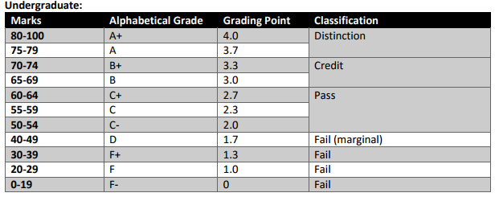
Achievement requirements

Slide 19
Question and Answer Session
Q & A

Slide 20
What we will cover next
Data vs Information
Types of Database

